Slide 1
RECURSION IN ASSEMBLY LANGUAGE

Slide 2
Recursion
A recursive subroutine is one that calls itself, either directly or indirectly. Recursion, the practice of calling recursive subroutines, can be a powerful tool when working with data structures that have repeating patterns. Examples are linked lists and various types of connected graphs where a program must retrace its path.

Slide 3
Endless Recursion
The most obvious type of recursion occurs when a subroutine calls itself. The following program, for example, has a procedure named endless that calls itself repeatedly without ever stopping:
endless: mov ax, bx
call endless
ret
start: call endless
mov ax, 0x4c00
int 21h

Slide 4
Useful recursive subroutines
Useful recursive subroutines always contain a terminating condition. When the terminating condition becomes true, the stack unwinds when the program executes all pending RET instructions.
There are two cases in recursion: base case and recursive case
To illustrate, let’s consider the recursive procedure named calcsum, which sums the integers 1 to n,
int calsum(int n)
{
if (n==0) // termination condition
return 0
int x=calsum(n-1) // recursive call
return n+x
}

Slide 5
Useful recursive subroutines
Code in assembly:
Consider array is global and n is an input parameter passed in CX. calcSum returns the sum in AX
[0rg 0x0100]
jmp start
calSum: cmp cx,0 ; check termination condition
je l2
add ax, cx
dec cx
call calSum
l2: ret
start: mov cx, 4
mov ax, 0
call calSum
l1: mov ax, 4C00h
int 21h

Slide 6
Stack and Registers on Calls
Calls if n =5
ax=0 cx=5 and L1 is pushed on stack (first call to calSum(5))
ax=5 cx=4 and L2 is pushed on stack (recursive call to calSum(4))
ax=9 cx=3 and L2 is pushed on stack (recursive call to calSum(3))
ax=12 cx=2 and L2 is pushed on stack (recursive call to calSum(2))
ax=14 cx=1 and L2 is pushed on stack (recursive call to calSum(1))
ax=15 cx=0 and L2 is pushed on stack (recursive call to calSum(0))
Ret by calSum(0), ax=15 cx=0
Ret by calSum(1), ax=15 cx=0
Ret by calSum(2), ax=15 cx=0
Ret by calSum(3), ax=15 cx=0
Ret by calSum(4), ax=15 cx=0
Ret by calSum(5), ax=15 cx=0
Final answer is in ax=15

Slide 7
STEPS : How to Call the Recursive Function
Create Space for Result on Stack (Result space)
Prepare and Push input parameters on the stack
Call your Recursive Function (Subroutine)
Use the results (Pop from stack)

Slide 8
STEPS : To Write the Recursive Function /Subroutine
Save all registers used in this function/Subroutine on to the stack
Write your base Condition (go to step e after this)
Write your non base condition in which you call the same subroutine again(next call using step 1 to 3)
Use the results from this call (Pop the result from stack and do all the necessary calculations)
Push the result in stack (on Result space created in step 1)
restore all registers back from the stack(Saved in Step a)
release/pop the stack (Except for the Result - step 1 and e) and Exit

Slide 9
Note: DO ALL THIS WHILE KEEPING IN MIND THE POSITION OF VARIABLES ON STACK
SO that you can access your variables

Slide 10
Example:
This example will show all these steps for Factorial Calculating Function
int factorial(int n){
if(n==0 || n==1) ; Base Condition
return 1;
else
return n*factorial(n-1); Non Base Condition
}

Slide 11
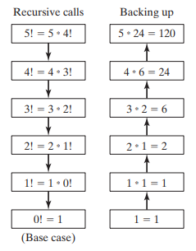

Slide 12
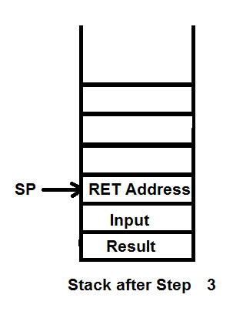
A ). First Write your Main
main:
push ax ; Step 1 :Create Space for Result on Stack (Result space)
push 3 ; Step 2 : Push input parameters on the stack
call fact ; Step 3: Call your Recursive Function (Subroutine)
pop ax ; Step 4: Use the results (Pop from stack)
;ax will have the result of fact
mov ax,0x4c00 ; Terminate
int 21h

Slide 13
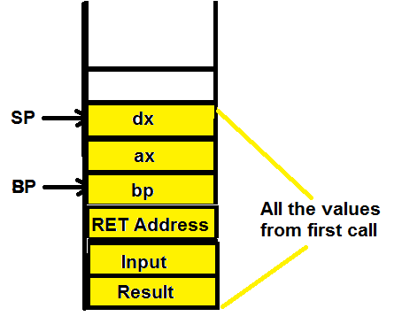
B). Write your Subroutine
Step a. Save all registers used in this function/Subroutine on to the stack
push bp
mov bp,sp
push ax
push dx
Note: You can modify this step on end
once you finalize which registers you
will be using in your subroutine

Slide 14
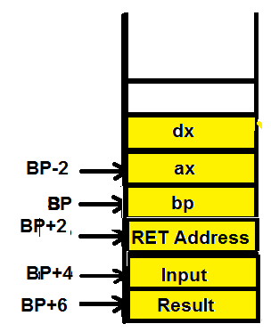
Step b. Write your base Condition
In C++
if(n==0 || n==1) ; Base Condition
return 1;
In Assembly
cmp word [bp+4] , 1 ; if n==1
je exit
cmp word [bp+4] , 0 ; if n==0
je exit
exit:
mov word [bp+6], 1 ; Return 1 (Placing 1 at result position) Step e.

Slide 15
Step c . Write your non base condition in which you call the same subroutine again(next call using step 1 to 3)
sub sp, 2 ; Step 1 Create Space for Result on Stack (Result space)
mov ax, [bp+4] ; Creating the input
dec ax
push ax ; Step 2 : Push input parameters on the stack (n-1)
call fact ; Step 3: Call your Recursive Function (Subroutine)
Step d . Use the results from this call (Pop the result do all the necessary calculations)
pop ax ; returned result
mov dx,0 ; Initialization for MUL
mul word [bp+4] ; ax= n* f(n-1) i.e. [bp+4] * ax
Note : BP+4 was the input for this call

Slide 16
Step e. Push the result in stack (on Result space created in step 1)
mov [bp+6], ax ; result
Step f. restore all registers back from the stack(Saved in Step a)
jmp exit2
exit2:
pop dx
pop ax
pop bp
; Note this is in reverse order as of Step a where we push bp first then ax and rhen dx
Step g. release/pop the stack and Return (Except for the Result - step 1 and e)
Ret2

Slide 17
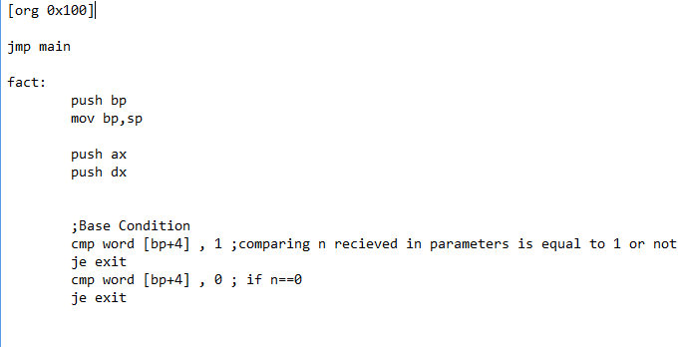
Summing Up all the code

Slide 18
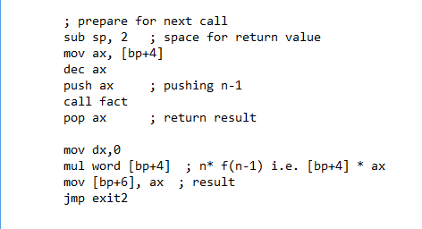

Slide 19
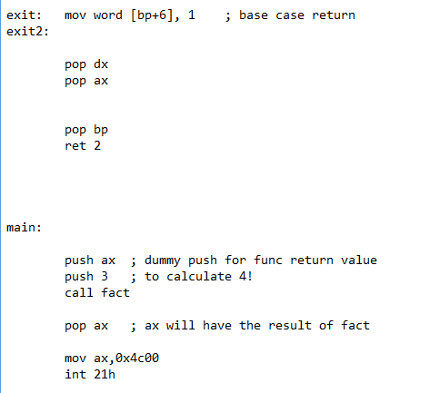

Slide 20
Exercise 1 : Fibonacci
Go through all these steps to create a recursive function FIB
int fibo(int x){
if (x==1 || x==0)
return x;
else
return fib(x-1)+fib(x-2);
}

Slide 21
Exercise 2 : Palindrome
Write this recursive function in Assembly language following all
the steps given in slides
int palindrome(char* str, int length) { if (length<=1) return 1; else return (palindrome(str+1, length-2) && (*str== *(str+length-1))); }

Slide 22
Exercise 3 : Tower of Hanoi
Follow the link to understand the problem of tower of Hanoi and using the given pseudo code on link write an assembly language code to solve this problem
https://www.cs.cmu.edu/~cburch/survey/recurse/hanoiimpl.html

Slide 23
References
https://sites.google.com/view/coal-fall-2019

